Slide 1
Group Assignment - Marketing & Retail Analytics
Analysis on Cafe Coffee Night Data set
Group Members : Umesh Bhatt , Pratyus Choudhary , K Anirutha Kesavan , Siddharth Vaishnav

Slide 2
Assignment Details
The data set provided to you is the data set of Café Coffee Night for one of its restaurants. Do a thorough analysis of the data and come up with the following analysis:
• Exploratory Analysis
• Menu Analysis
• Recommendation
Exploratory Analysis
Exploratory Analysis of data & an executive summary of your top findings, supported by graphs.
What kind of trends do you notice in terms of consumer behavior over different times of the day and different days of the week? Can you give concrete recommendations based on the same? 10 Marks
Are there certain menu items that can be taken off the menu?
Are there trends across months that you are able to notice?
Menu Analysis
Identify the most popular combos that can be suggested to the restaurant chain after a thorough analysis of the most commonly occurring sets of menu items in the customer orders. The restaurant doesn’t have any combo meals. Can you suggest the best combo meals?

Slide 3

Exploratory Data Analysis

Slide 4
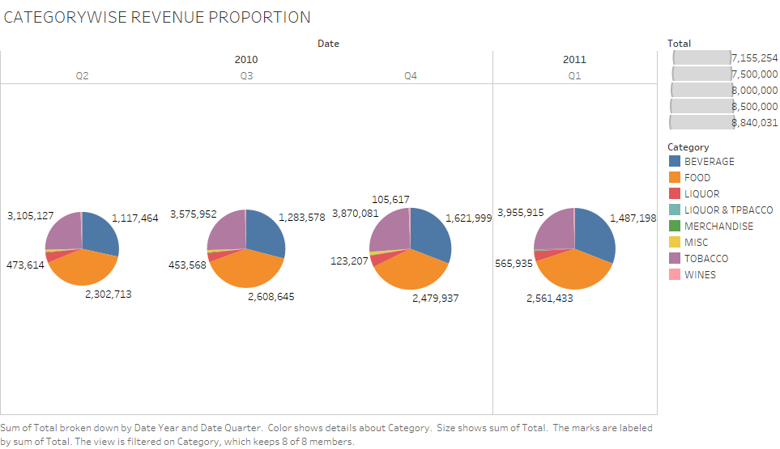

Slide 5
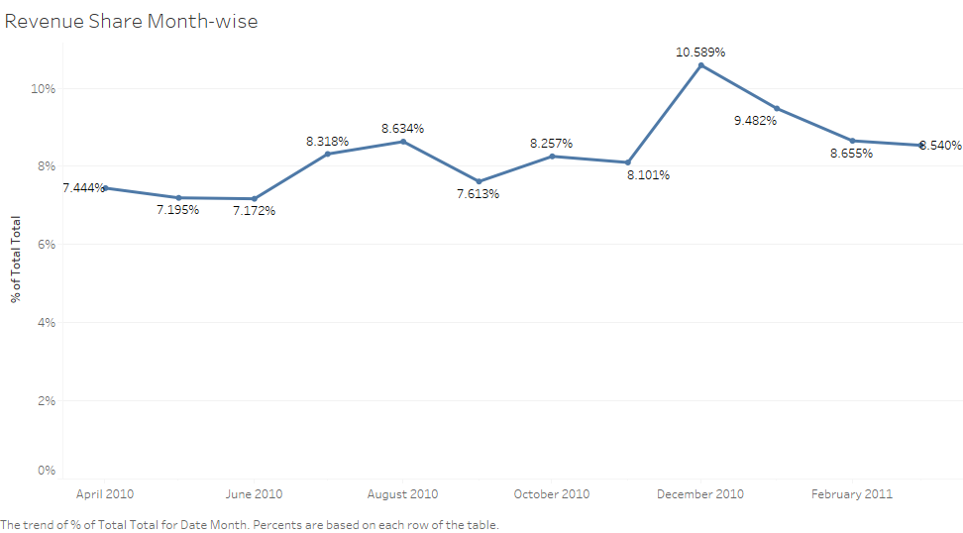
December Month has highest Revenue 10.59 % in the Financial Year

Slide 6
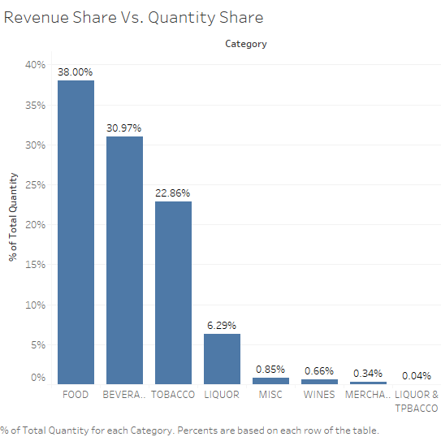
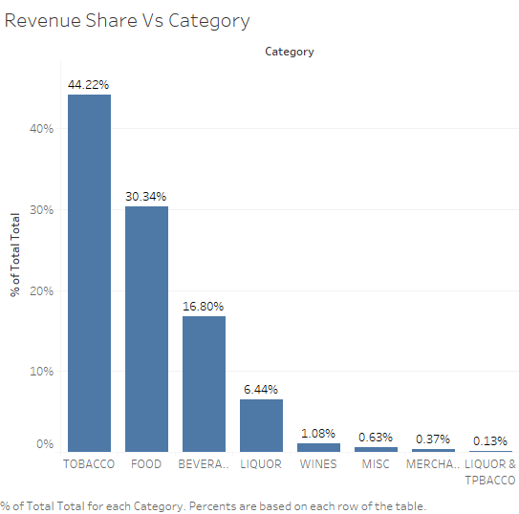
Revenue Share Vs. Quantity Share
Food is sold the most. Tobacco holds the top revenue share

Slide 7
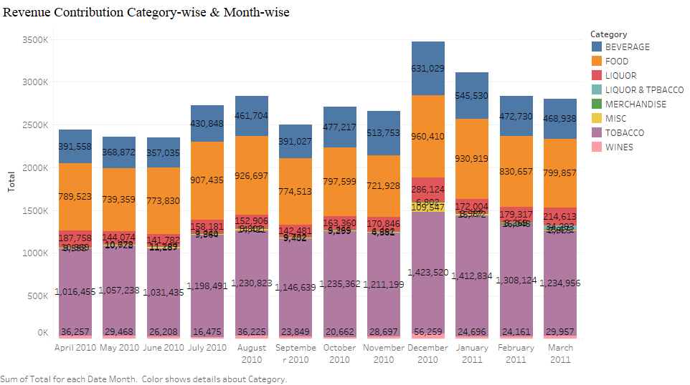
Revenue Contribution Category-wise
Tobacco, Food and Beverages are top contributors

Slide 8
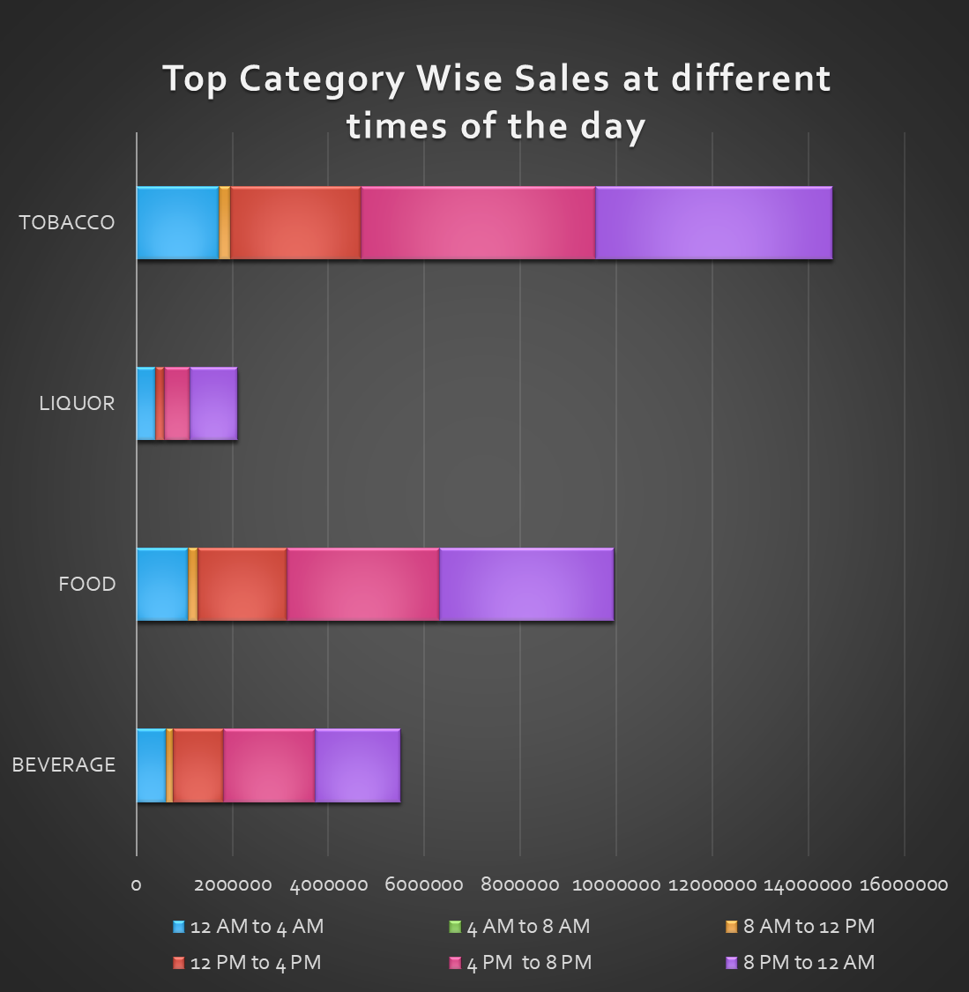
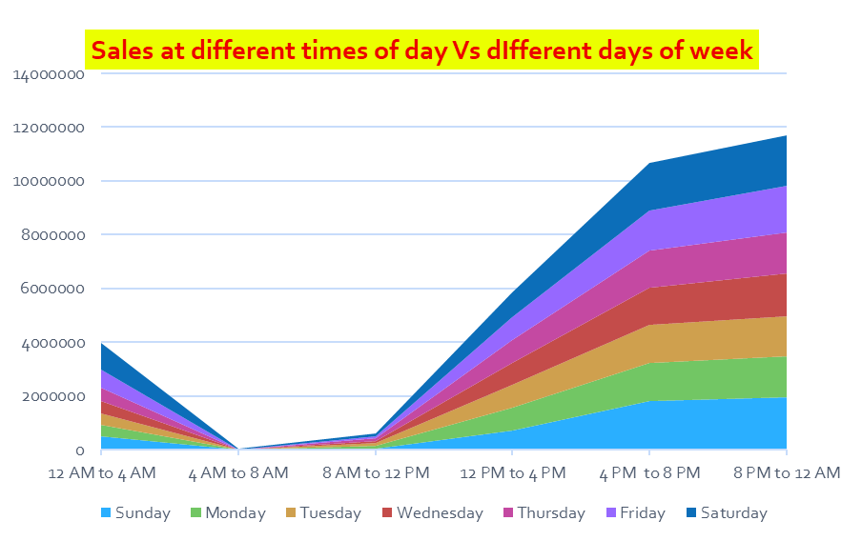
Peak time for selling Food items is from 4PM to midnight
Peak time of selling Beverages are from 4PM to 8PM
Peak time for selling Tobacco is from 8PM till midnight
Peak time for selling Liquor is from 8AM to midnight
Tobacco and Wine are sold throughout the day but increases up in night.
Merchandise, Miscellaneous and Liquor and tobacco are the categories of product sold mostly in night.

Slide 9
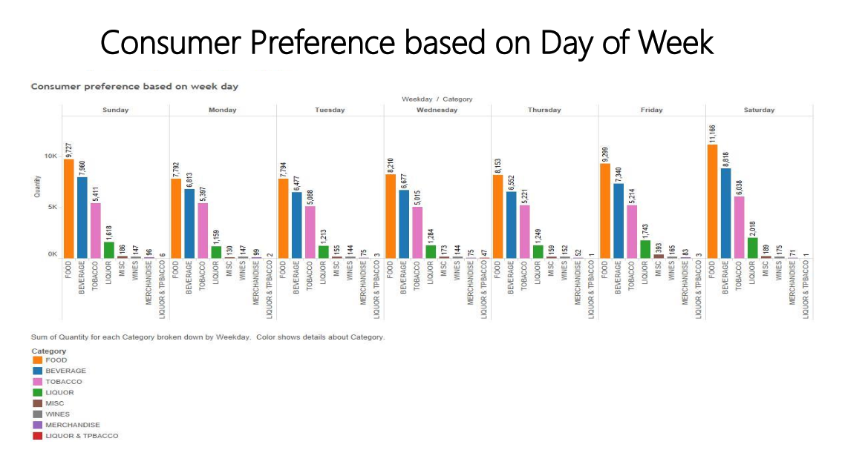
Food along with Tobacco has the highest reference on Saturday

Slide 10
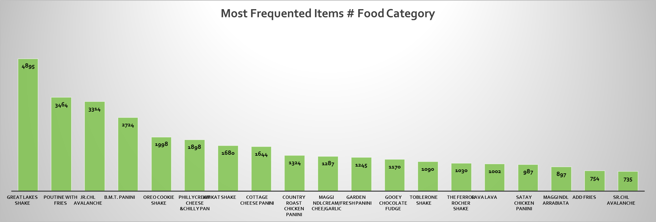
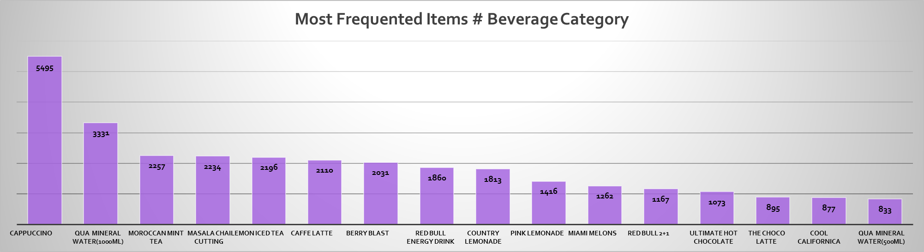

Slide 11
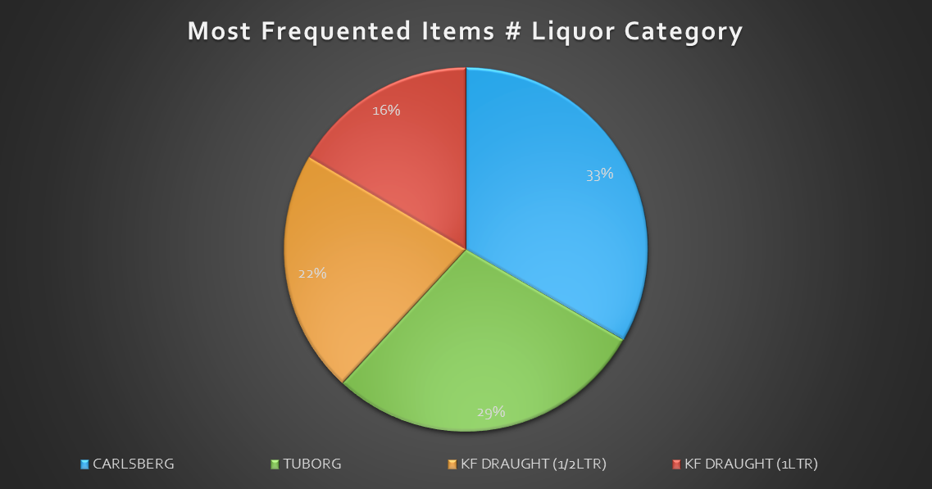

Slide 12
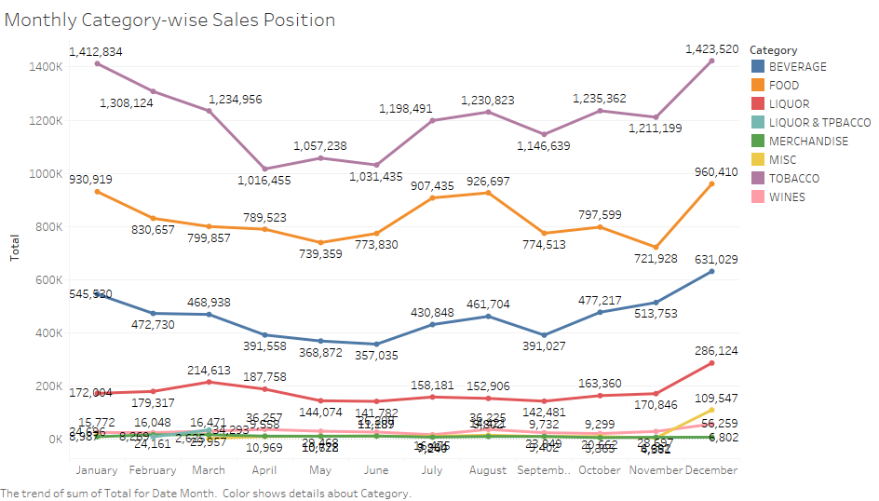
From Jan till June sales usually is low for all the products.
Sales of products increases from June and peak up in December.
The months of July and August register a sharp increase in sales for Food and Beverage
Liquor and Tobacco shows contrasting trends for other months except December when the sale peaks up for both alike.

Slide 13
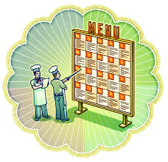
Menu Analysis

Slide 14
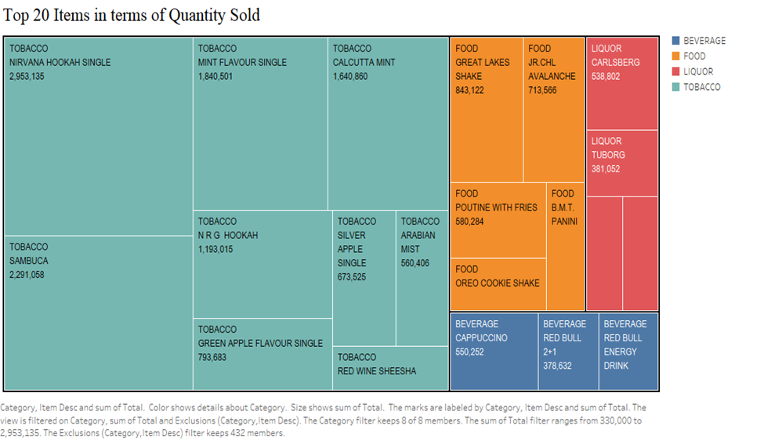
Top 20 Items in terms of Quantity Sold

Slide 15
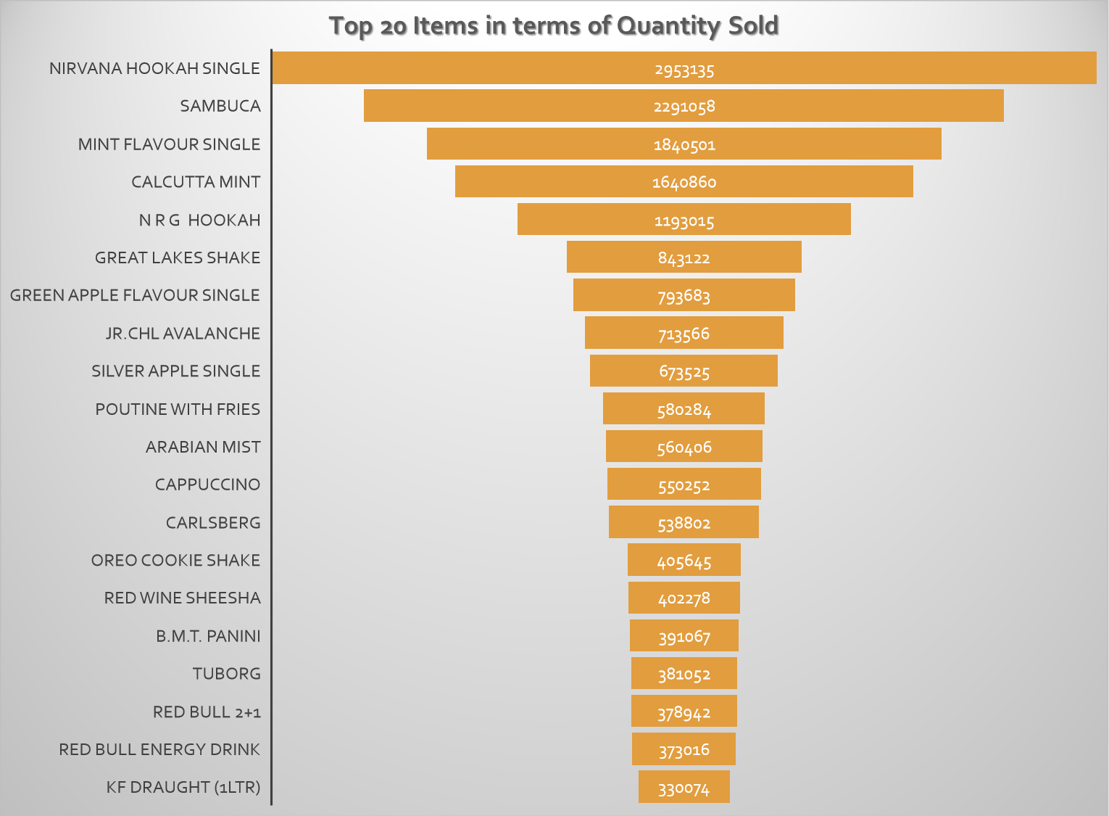

Slide 16
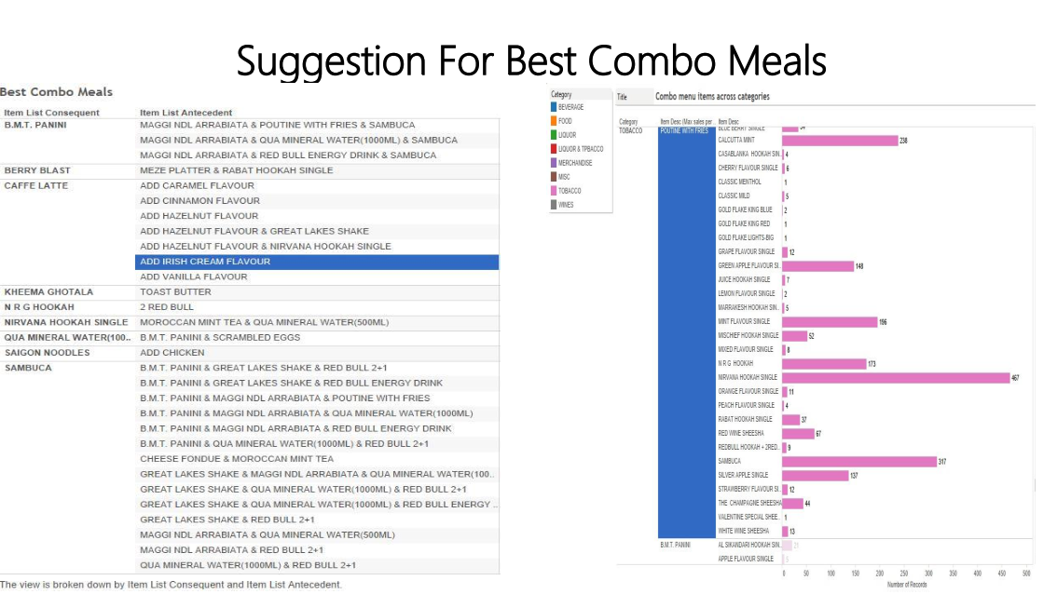

Slide 17
Observations
Most customer prefer Kheema ghotala with toast butter with more 115 time than any other customer with more than 50% of confidence.
Most customer prefer café latte with vanilla, Irish cream, caramel, cinnamon and hazelnut flavor with more 20 time than any other customer with more than 60% of confidence.
Most customer prefer cappuccino with Hazelnut or Whipped Cream with more 5 time than any other customer with more than 40% of confidence.
Most customer prefer Saigon noodles with chicken with more 950 time than any other customer with more than 40% of confidence.
Most customer prefer Red bull with N.R.G Hookah with more 25 time than any other customer with more than 80% of confidence.
Most customer prefer Red bull, Maggie noodles arrabiata with Sambuca with more 8 time than any other customer with more than 50% of confidence.

Slide 18
Observations
Most customer prefer B.M.T. Panini, Red bull with Sambuca with more 7 time than any other customer with more than 40% of confidence.
Most customer prefer fries, masala chai with B.M.T. Panini with more 11 time than any other customer with more than 40% of confidence.
Most customer prefer qua water, fries, sambuca with B.M.T. Panini with more 11 time than any other customer with more than 40% of confidence.
Most customer prefer Vanilla ice cream with mocha shake with more 5 time than any other customer with more than 40% of confidence.
Most customer prefer Saigon noodles with chicken with more 950 time than any other customer with more than 40% of confidence.

Slide 19

Recommendations

Slide 20
Top selling Category of the product for the Café is Tobacco, Food, Beverage, Liquor.
Sales of most products starts increasing on Friday and reaches a peak on Saturday .
Merchandise, Miscellaneous and Liquor and tobacco are the categories of product sold mostly in night.
Sales show steady progress from 1100 hours onwards. Restaurant makes max sales in the evenings between 19:00-23:00 hours. Peak time is 19:00-20:00 hours.
Tobacco and Wine are sold throughout the day but increases up in night.
Sales of products increases from June and peak up in Dec month.
Add-ons to increase the Sales
Give Happy hours offer in liquor category to increase the sales of the liquors during day time.
Combine the food products with tobacco product with discounted prices.
Combine different food products and sales them at discounted prices.
Operate the store during morning time to increase the sales and include breakfast items.
During weekday sells the products at discount prices.
Combination or introducing buy 2 and get 1 scheme.
Combine Hookah with food or beverage or liquor items to increase the sales.
Increase the sales of merchandise by providing them at discount price with different food .

